Slide 1
Bazele inteligenței artificiale
Laborator – Grigore Ionuț

Slide 2
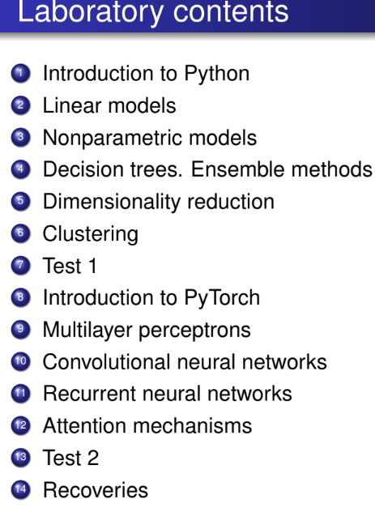

today’s lab

Slide 3
Content
Linear regression
Gradient descent
Polynomial regression
Regularized linear models
Logistic regression
Softmax regression

Slide 4
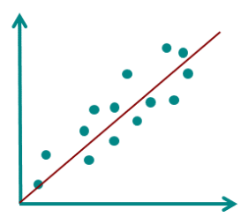
1) Linear regression

Slide 5
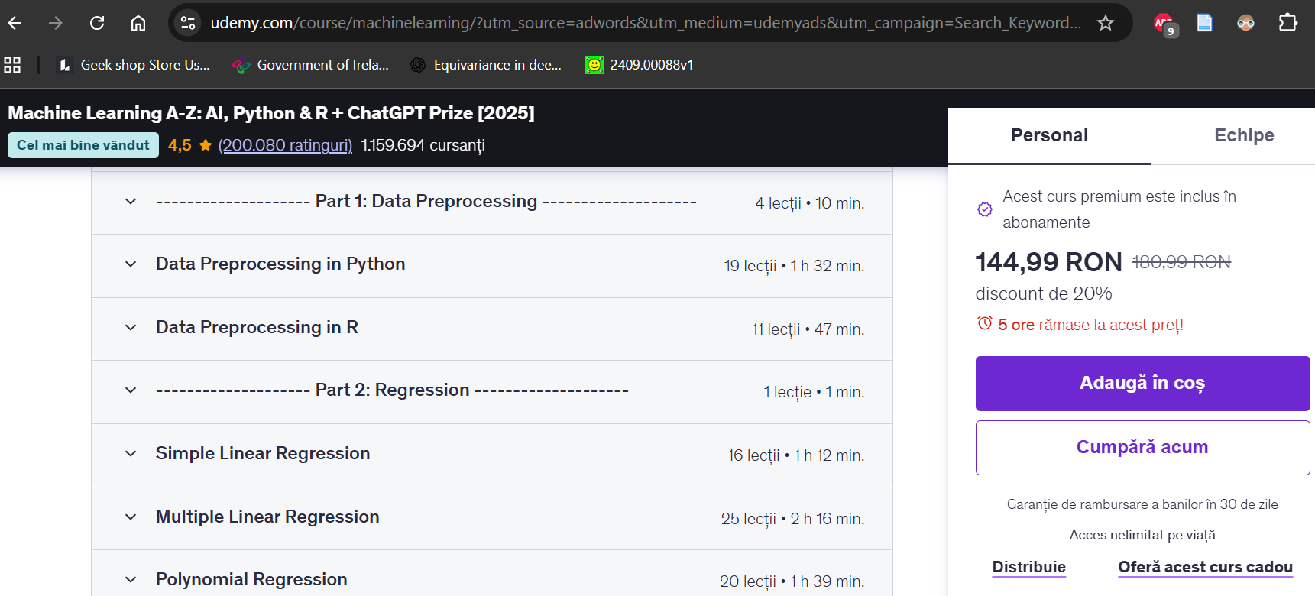
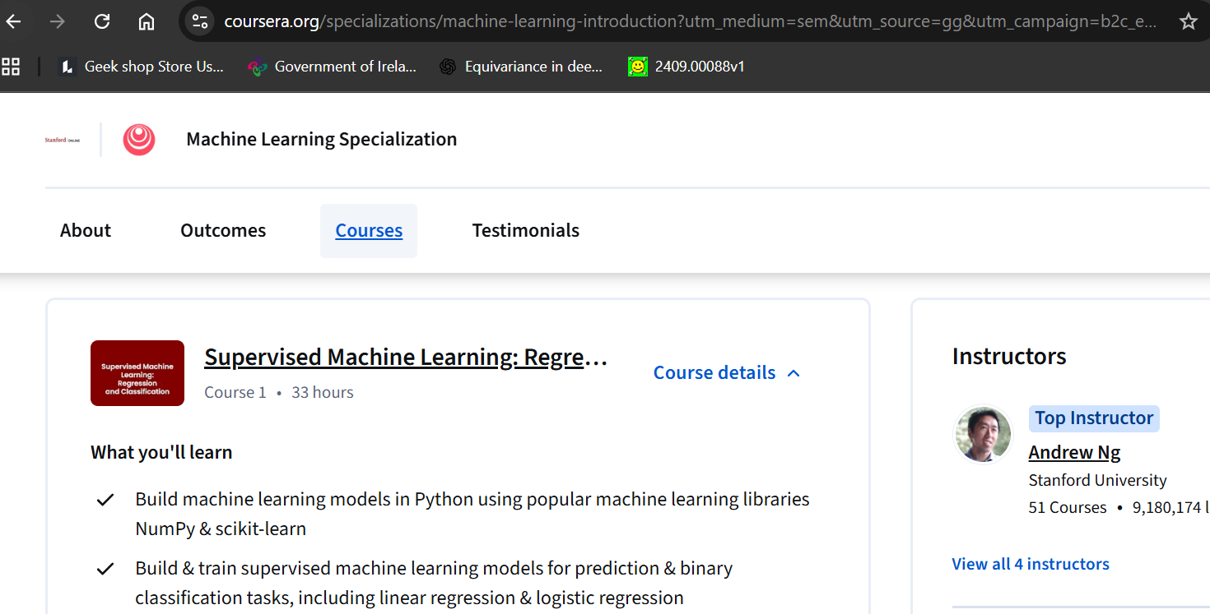


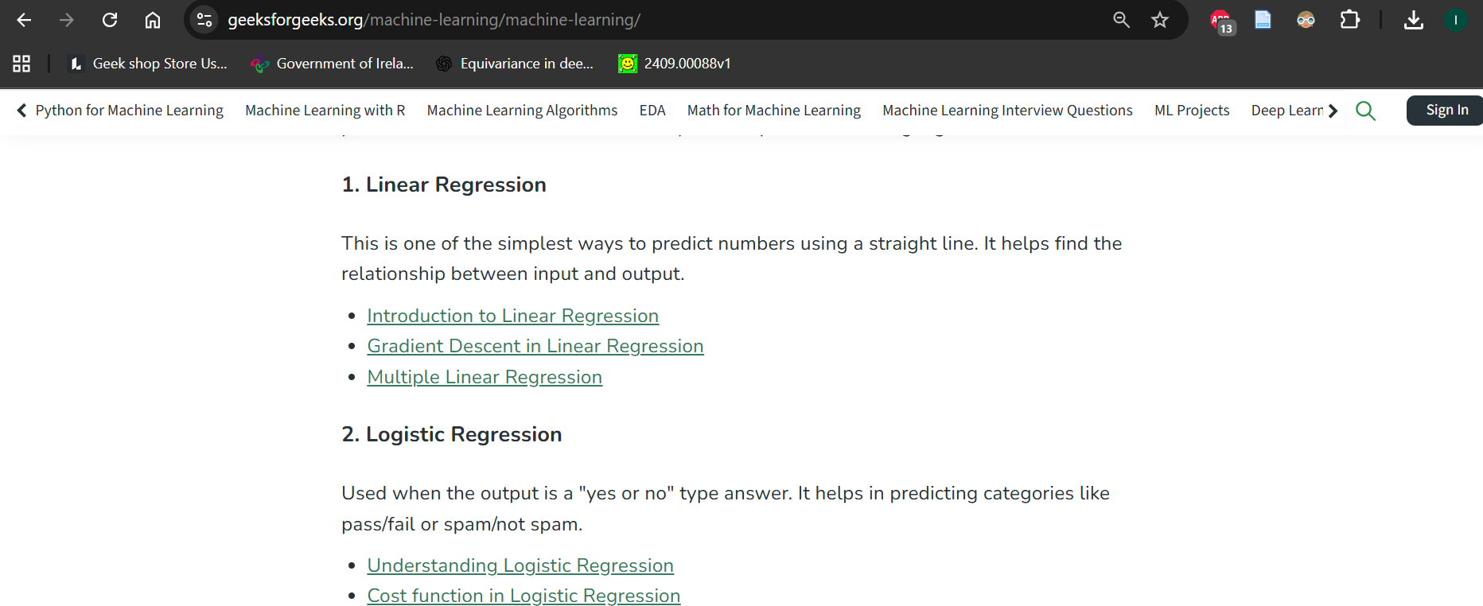



Most ML courses begin with linear regression, as it introduces the essential concepts of learning from data.
Linear regression = the “hello world” of ML

Slide 6
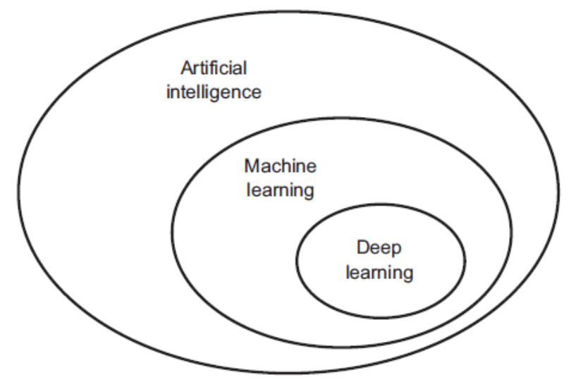
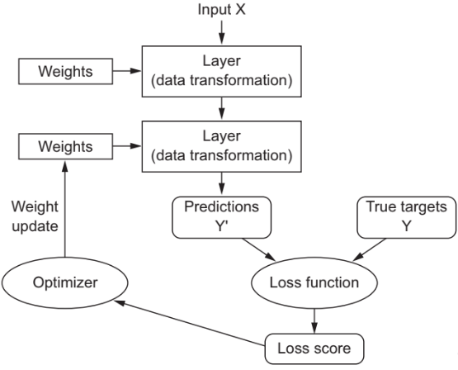
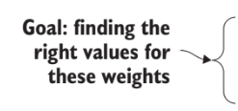


































































does not involve learning from data !
learn from data to make predictions or decisions!
(the models are “TRAINED”!)
ML/DL
model

Slide 7
A simple example to understand the problem

Slide 8
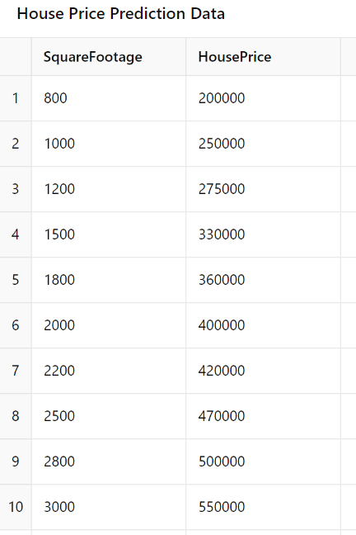
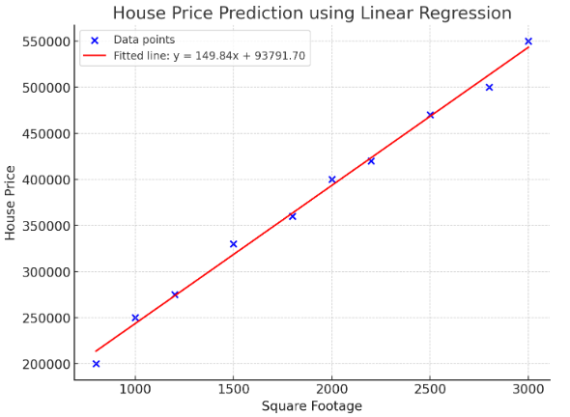
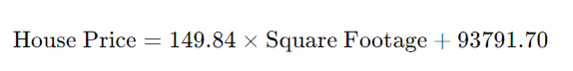






(2D)

Slide 9
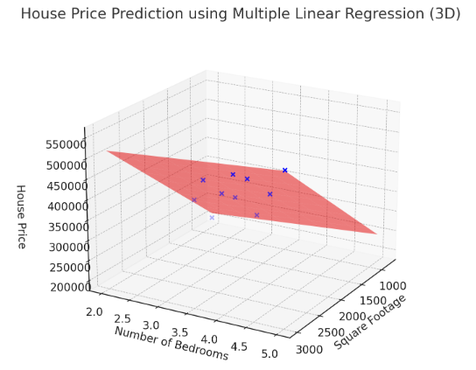
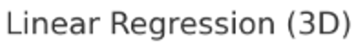
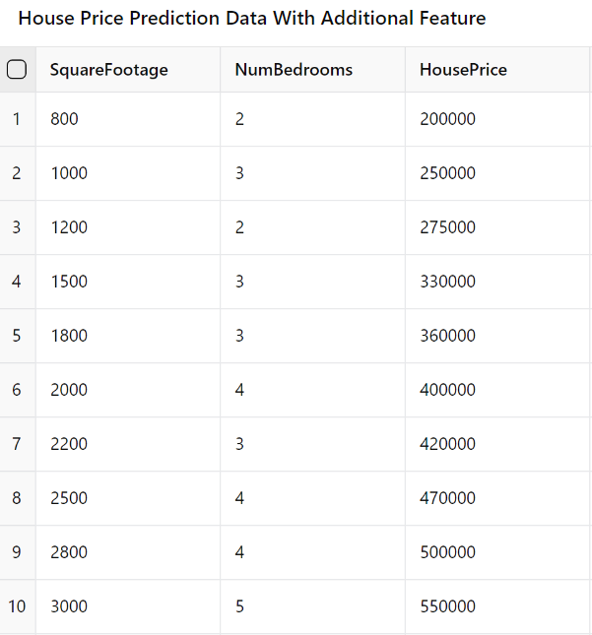









Slide 10
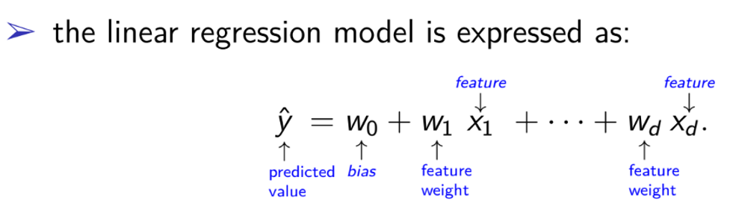
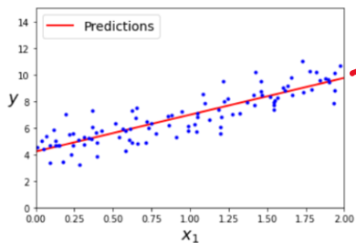
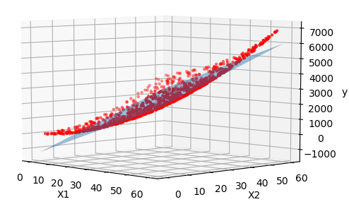
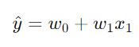
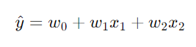






UDL Interactive Figures
see here 2.2 Least squares loss
d=2
d=3
equation of a line
equation of a plane
NOTE:
We cannot plot more than 3 dimensions ! ☺ (actually we can but it’s more tricky)

Slide 11
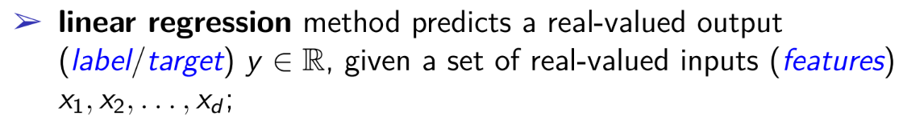

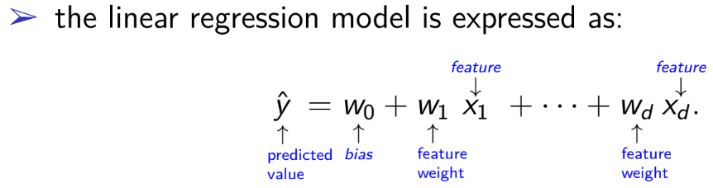


training dataset – each row is called: example or data point or sample

Slide 12
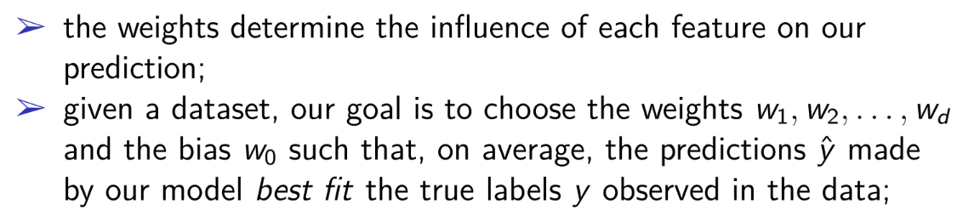

Slide 13
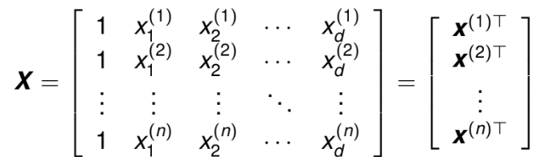
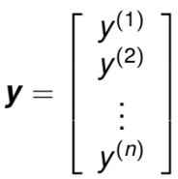
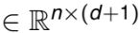
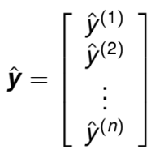
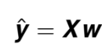






One input-output pair or one training example/sample
features of the training dataset
corresponding (known) labels
training dataset
We want them to be the same!
linear regression model
predictions
true (known) labels

Slide 14
Loss function

Slide 15
























does not involve learning from data !
learn from data to make predictions or decisions!
(the models are “TRAINED”!)
ML/DL
model

Slide 16

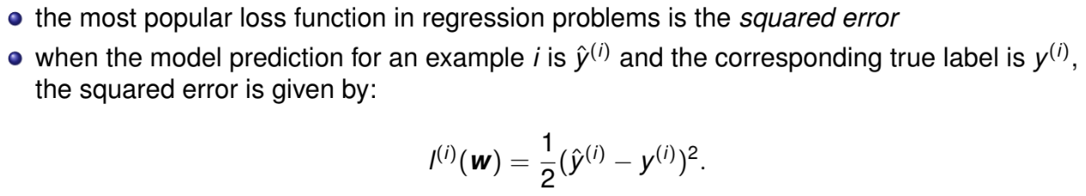
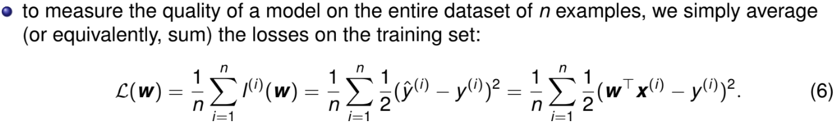










we must create a formula for the loss function !
the quality measure for a certain ML model is given by the loss function which quantifies the distance between the real and predicted value of the target (smaller values are better and perfect predictions have a loss of 0)
NOTE: the constant ½ will cancel out when we take the derivative of the loss !
mean squared error loss function

Slide 17

A probabilistic interpretation of linear regression
(the ugly part from the course with probabilities ☺ )

Slide 18

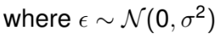
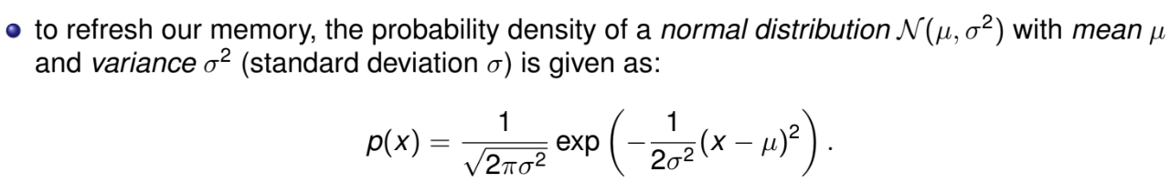


Measurement errors: Imperfections in the instruments or processes used to collect data.
External factors: Influences from environmental variables that aren’t modeled.
etc.
Example:
Imagine you're collecting data on house prices and you expect a linear relationship between the size of a house and its price. However, in reality, other factors (like the neighborhood, condition of the house, economic conditions) introduce noise into the data, so the actual price of a house deviates from the expected price based on its size.

Slide 19
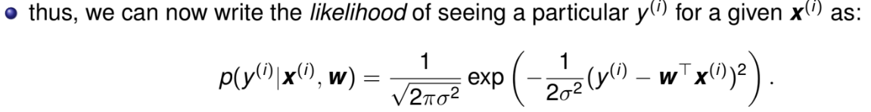


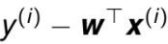



residual error follows a normal distribution with mean 0 and variance
the likelihood of appearing the residual error
The smaller the residual , the higher the likelihood of observing that data point
The higher the residual , the smaller the likelihood of observing that data point

Slide 20
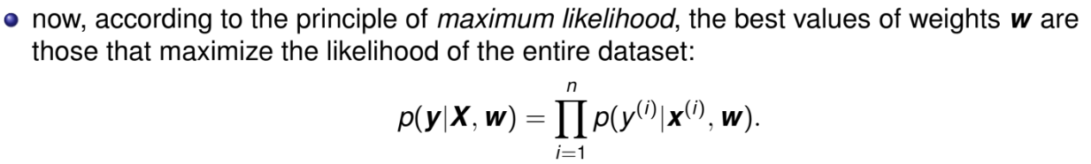
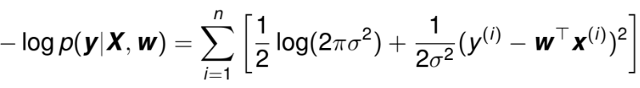






we want to maximize this!
mathematical proof on the next slide
maximizing the product of many exponentials might be difficult, so we instead minimize the following:
we want to minimize this!
negative log-likelihood

Slide 21
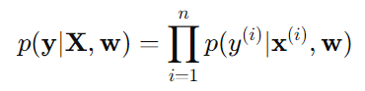
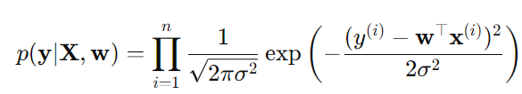
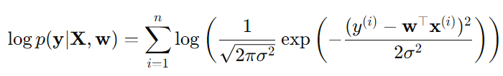
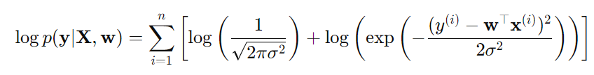
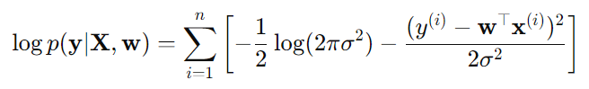
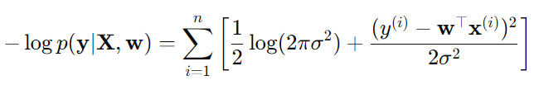










log
We used log(ab) = log(a) + log(b), thus the product became sum
We used the same formula as above ☺

Slide 22
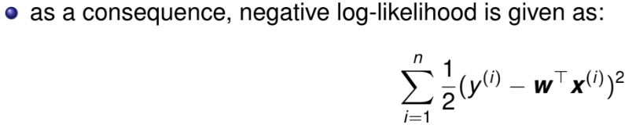
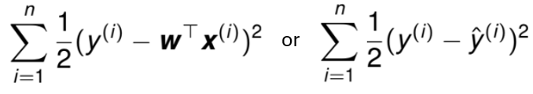
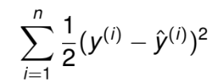
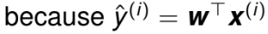























fixed, so we ignore it
fixed, so we ignore it
we want to minimize this!
or
we want to minimize this!
We will see why we keep this ½ factor

Slide 23
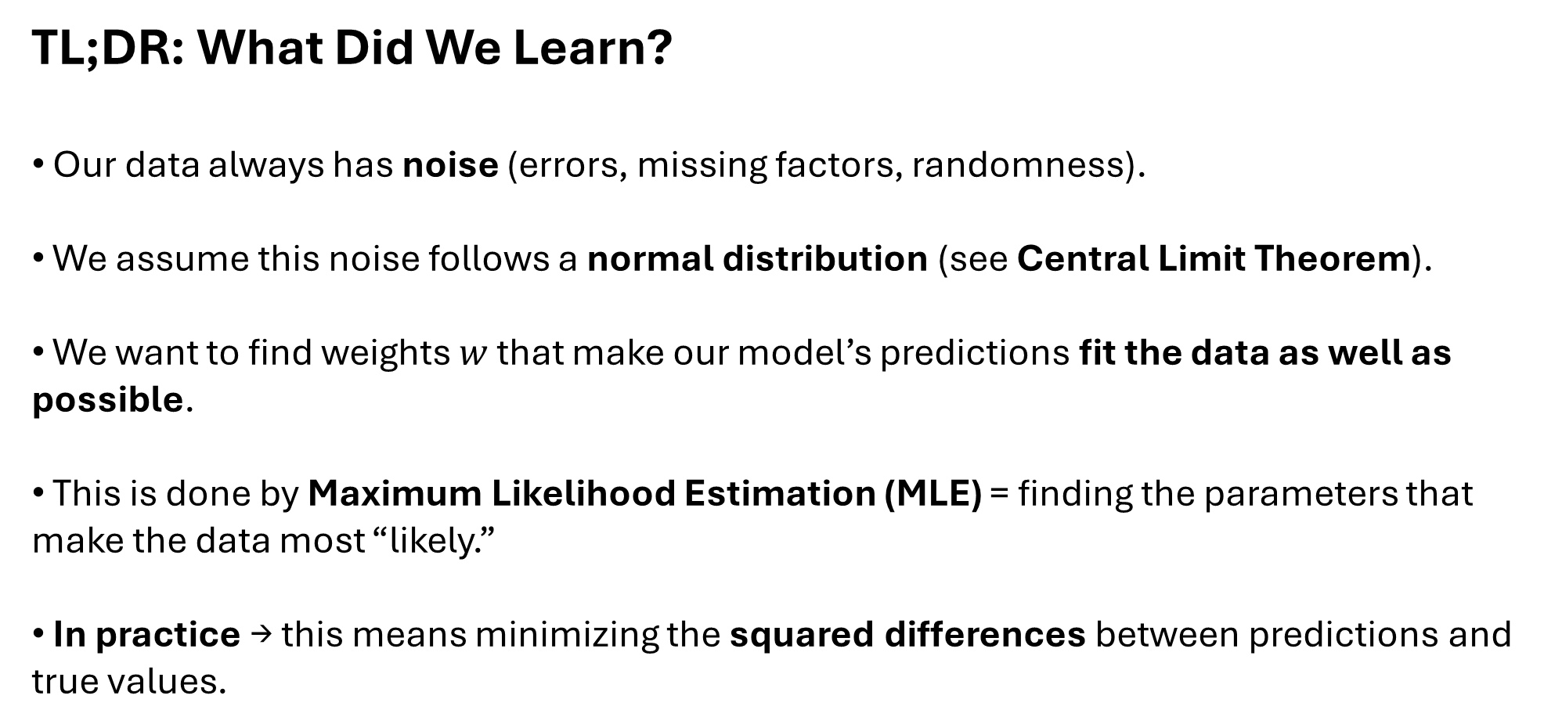
TL;DR: What Did We Learn?
Our data always has noise (errors, missing factors, randomness).
We assume this noise follows a normal distribution (see Central Limit Theorem).
We want to find weights $w$ that make our model’s predictions fit the data as well as possible.
This is done by Maximum Likelihood Estimation (MLE) = finding the parameters that make the data most “likely.”
In practice → this means minimizing the squared differences between predictions and true values.

Slide 24
How do we find weights w?

Slide 25






does not involve learning from data !
learn from data to make predictions or decisions!
(the models are “TRAINED”!)
ML/DL
model

Slide 26
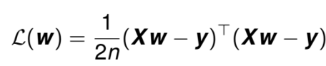
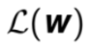
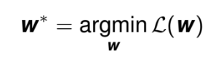

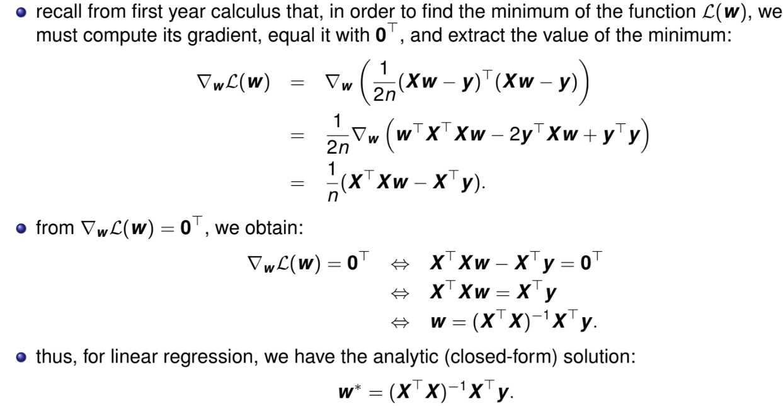





















the mean squared error can be written as:
now we want to find the parameters w that minimizes the total loss across all training samples, :

Slide 27
Code part

Slide 28













Method 1. Implement manually
The equation of the red line is:
4.215 + 2.770*x

Slide 29







Method 2. Use scikit-learn

Slide 30

2) Gradient descent

Slide 31


Slide 32

see here 2.4 Loss function:
UDL Interactive Figures

Slide 33

















The normal equation gets very slow when the number of features grows large (e.g., 100, 000) !
NOTES: when the matrix X^{T}X is not invertible (e.g. when d > n or if one or more columns in X are identical), then we need to use single value decomposition (SVD) to compute the matrix (X^{T}X)⁻¹X^{T} which is called the pseudoinverse matrix of X a complexity of about
The SVD gets very slow when the number of features grows large (e.g., 100, 000) !

Slide 34

















Solution: gradient descent !
NOTES:

Slide 35






















ML/DL
model
initially random
numbers
“alien”
“dog”
2.8 - high

Slide 36

ML/DL
model
slightly better
numbers
“wolf”
“dog”
0.9 - medium

Slide 37

ML/DL
model
very good
numbers
“dog”
“dog”
0.05 - low

Slide 38






https://www.youtube.com/watch?v=5H7M5Vd3-pk&list=PLpFsSf5Dm-pd5d3rjNtIXUHT-v7bdaEIe&index=12
Why this formula?
What is the derivative of a function?
h
the derivative of a function f(x) at a point a gives the slope of the tangent line to the graph of the function at that point.

Slide 39












A positive derivative means the function is increasing.
A negative derivative means the function is decreasing.
If is positive means the function is increasing, so by subtraction means that we go in the opposite direction (of decreasing the function)
If is negative means the function is decreasing, so by subtraction means that we keep the direction of decreasing
gradient (slope of tangent) is negative
gradient (slope of tangent) is positive
gradient (slope of tangent) is zero

Slide 40


Some notes…
If the learning rate is too high, we might jump across the valley and end up on the other side, possibly even higher up than we were before and this might make the algorithm diverge
If the learning rate is too small, the algorithm will have to go through many iterations to converge, which will take a long time

Slide 41






Some notes…
If the random initialization starts the algorithm on the left, then it will converge to a local minimum, which is not as good as the global minimum
Not all functions look nice, regular bowls
There may be holes, ridges, plateaus, etc., making convergence to the minimum difficult
If the random initialization starts the algorithm on the right, then it will take a very long time to cross the plateau and if we stop too early, we will never reach the global minimum

Slide 42
























Some notes…
see here 6.4 Gabor loss function:
UDL Interactive Figures
Fortunately, the mean squared error loss function for linear regression is always a convex function (“ține apa”)
This implies that there are no local minima, just one global minimum
Mean squared error loss function
Other loss function
vs
local minimum
global minimum
w₁
w₁
w₀
w₀

Slide 43
Code part

Slide 44





Method 1. Implement manually
go back to slide 24 to believe ☺

Slide 45












Method 1. Implement manually

Slide 46


















Method 1. Implement manually

Slide 47




Method 2. Use scikit-learn

Slide 48


Some notes…

Slide 49

3) Polynomial regression

Slide 50












Slide 51




!
Example: suppose we have the famous house price prediction problem! We have more features x₁, x₂, …. x_{d} representing:
x₁ – number of bedrooms
x₂ – square footage (“numărul de metri pătrați”)
x₃ – age of the house
….
Based on these features, we want to predict the price of the house !
If the data is linear, we can apply linear regression:
If the data is non-linear, we can apply polynomial regression:

Slide 52

NOTE 1):
In polynomial regression, we can introduce polynomial terms for each feature. This means not only do we include the original features, but we also add higher-order terms (e.g., squares, cubes) and interaction terms between features.
NOTE 2):
Polynomial regression is linear in terms of the parameters, even though it is non-linear with respect to the features !

Slide 53






The term "linear" here refers to how the model parameters (w₀, w₁, w₂,…) appear in the model. They are simply added together and are not multiplied by each other, nor raised to any power.
On the other hand, the features (x₁, x₂, x₃,…) are raised to higher powers (e.g., x₁²​, x₂³​ ) and/or multiplied together to create interaction terms (e.g., x₁​ ⋅ x₂​ )
This means that polynomial regression is linear in the parameters but non-linear in the features.

Slide 54



Linear vs Non-linear

Slide 55




So, polynomial regression is defined by:
The loss function used for polynomial regression is called called root mean squared error (RMSE):
non-linear transformation of inputs x

Slide 56


Bias/Variance trade-off
Suppose we have the following data (non-linear):
We want to apply polynomial regression for it:

Slide 57







low variance,
high bias
high variance,
low bias
best model !
Increasing a model’s complexity (big M) high variance and low bias overfitting
Decreasing a model’s complexity (small M) low variance and high bias underfitting

Slide 58

Overfitting/Underfitting
Underfitting occurs when a model is too simple to capture the underlying patterns in the data. It means the model does not fit the training data well and has high bias but low variance, resulting in poor performance on both training and test datasets.
Overfitting happens when a model is too complex and fits the training data "too well," even capturing noise and random fluctuations. As a result, it has low bias but high variance—it performs very well on the training data but poorly on unseen data because it lacks generalization

Slide 59



Overfitting/Underfitting
Overfitting (the nerd/egghead 🤓)
Studies every single detail of the textbook, even the footnotes and rare exceptions.
On the exam, if the exact same question from the book appears, he nails it.
But if the question is slightly different, he gets confused because he memorized instead of understanding.
Underfitting (the too-chill guy 😎)
Barely studies, just skims the summary.
On the exam, he can only answer the most obvious questions.
He misses the deeper or trickier ones because he didn’t learn enough detail.
Best fit (the actually smart guy 🧠)
Understands the material well, without obsessing over useless details.
On the exam, he can handle both the standard and the slightly different questions.

Slide 60









TL; DR
Linear Regression
Uses a straight line
Works well if the data has a linear trend
Struggles with curved/nonlinear patterns
Polynomial Regression
Transforms inputs into polynomial features
Can capture curved relationships in the data
Fits nonlinear trends much better

Slide 61
Code part

Slide 62






training data
We use fit_transform() method and PolynomialFeatures class to transform our training data, adding the square (second-degree polynomial) of each feature in the training set as a new feature
X[0], X[0]²

Slide 63




Now we can fit a LinearRegression model to this extended training data, thus obtaining polynomial regression:

Slide 64














use the trained polynomial regression model to predict new values across the input range and plot the smooth fitted curve over the data:

Slide 65

4) Regularized linear models

Slide 66

Ridge, Lasso, and Elastic Net Regression are 3 different types of linear regression techniques that use regularization to prevent overfitting by adding penalties to the to the loss function.
KIND REMINDER: the loss function for linear regression is:
(see slide 24 ☺)
it’s almost preferable to have at least a little bit of regularization, so generally we should avoid plain linear regression

Slide 67


























Slide 68
Code part

Slide 69















ŷ = 1.00 + 0.36·x₁
ŷ = 0.99 + 0.37·x₁
ŷ = 1.50 + 0.00·x₁

Slide 70
…or alternatively using stochastic gradient descent…

Slide 71







Slide 72

5) Logistic regression

Slide 73
A simple example to understand the problem

Slide 74
Student Name | Hours Studied | Result (Pass=1, Fail=0)
Alice | 0.5 | 0
Bob | 0.75 | 0
Charlie | 1 | 0
David | 1.25 | 0
Emma | 1.5 | 0
Frank | 1.75 | 0
George | 1.75 | 1
Hannah | 2 | 0
Ian | 2.25 | 1
Jane | 2.5 | 0
Kevin | 2.75 | 1
Liam | 3 | 0
Marie | 3.25 | 1
Nora | 3.5 | 0
Oliver | 4 | 1
Paul | 4.25 | 1
Rachel | 4.5 | 1
Sam | 4.75 | 1
Tom | 5 | 1
Victor | 5.5 | 1
Problem to Solve
We want to predict whether a student will pass or fail an exam.
Input: hours studied.
Output: binary result (Pass = 1, Fail = 0).

Slide 75



How Logistic Regression Works (Intuition)
We start just like linear regression: – Multiply inputs by weights and add them up (a linear combination):
Instead of keeping that raw number, we pass it through a special function → squashes any value into a range between 0 and 1. The output is interpreted as a probability (e.g. 70% chance to pass the exam): – Small values → close to 0 (low probability). – Large values → close to 1 (high probability).
Finally, we apply a threshold (commonly 0.5): – ≥ 0.5 → predict Pass – < 0.5 → predict Fail

Slide 76

Student Name | Hours Studied | Result (Pass=1, Fail=0)
Alice | 0.5 | 0
Bob | 0.75 | 0
Charlie | 1 | 0
David | 1.25 | 0
Emma | 1.5 | 0
Frank | 1.75 | 0
George | 1.75 | 1
Hannah | 2 | 0
Ian | 2.25 | 1
Jane | 2.5 | 0
Kevin | 2.75 | 1
Liam | 3 | 0
Marie | 3.25 | 1
Nora | 3.5 | 0
Oliver | 4 | 1
Paul | 4.25 | 1
Rachel | 4.5 | 1
Sam | 4.75 | 1
Tom | 5 | 1
Victor | 5.5 | 1

Slide 77








it’s a binary classifier !
sigmoid function

Slide 78



















The loss function for a single training instance x is:

Slide 79













log loss

Slide 80
Code part

Slide 81



















a famous dataset that contains the sepal and petal length and width of 150 iris flowers of 3 different species: iris setosa, iris versicolor, and iris virginica.
3 classes
4 features

Slide 82













Inspecting the data…
first flower from the dataset
second flower from the dataset
0: setosa
1: versicolor
2: virginica

Slide 83






Before making the split, the train_test_split() method shuffles the dataset using a pseudorandom number generator.
If we just took the last 25% of the data as a test set, all the data points would have the label 2, as the data points are sorted by the label (see the output for iris['target'] shown earlier).
Using a test set containing only one of the three classes would not tell us much about how well our model generalizes, so we shuffle our data to make sure the test data contains data from all classes.
Sanity check:
NOTE:
If you want to split the dataset different than 75% and 25% you need to modify the default parameters of the train_test_split() function

Slide 84












Let’s now use logistic regression to build a binary classifier to detect the iris virginica type. Basically, we will have two classes: iris virginica and not iris virginica. We transform the targets correspondingly:
Now let’s train a LogisticRegression model:
In order to evaluate the accuracy of the logistic regression model on the test set, we use the score() method:
our model correctly classified 97.3% of the examples in the test set !
We can use the predict() method to apply the trained model on the first example in the test set:
The model predicted that the first example in the test set is an iris virginica!

Slide 85



We can also inspect the probabilities the model assigned to the negative and positive classes, respectively, using the predict_proba() method:
The model is 91.5% sure that the example is an iris virginica!

Slide 86

6) Softmax regression

Slide 87
A simple example to understand the problem

Slide 88

Student Name | Hours Studied | Class participation (0-10) | Final Grade
Alice | 5 | 8 | A
Bob | 4 | 7 | B
Charlie | 2 | 6 | C
David | 1 | 4 | D
Emma | 3 | 5 | C
Frank | 6 | 9 | A
George | 2 | 3 | D
Hannah | 4 | 7 | B
Ian | 5 | 8 | A
Jane | 3 | 6 | B

Slide 89













NOTE:

Slide 90








The loss function used for softmax regression is called called cross entropy loss and it captures the difference between predicted probabilities and the actual labels:
number of training instances
number of classes

Slide 91










m
m
Used for logistic regression
Used for softmax regression

Slide 92
Code part

Slide 93















Switch from logistic to softmax regression
A variant of stochastic gradient descent
Let’s use softmax regression to classify the iris flowers into the 3 classes:
Used for l₂ regularization
our model correctly classified 97.3% of the examples in the test set!
Again, we can use the predict() method to apply the trained model on the first example in the test set:
The classes are the original ones: 0 - setosa, 1 - versicolor, and 2 - virginica. Thus, the model thinks that the first example in the test set is an iris virginica !

Slide 94



We can again inspect the probabilities the model assigned to the three classes, using the predict_proba() method:
This model is 99.7% certain that the first example in the test set is an iris virginica. The first two probabilities correspond to the setosa and versicolor classes, respectively.
We can verify that the three probabilities add up to 1, meaning that the model outputs a probability distribution over the three classes.

Slide 95
Linear Regression: Learn a straight-line relationship between inputs and outputs.
Gradient Descent: Iteratively adjust weights to minimize the error.
Polynomial Regression: Extend linear regression to capture curved relationships.
Regularized Models (Ridge/Lasso): Prevent overfitting by penalizing large weights.
Logistic Regression: Turn regression into binary classification using the sigmoid function.
Softmax Regression: Generalize logistic regression to handle multiple classes.

Slide 96
Exercises

Slide 97


Slide 98



Solutions

Slide 99















why this shape for w? ☺
why this formula? ☺

Slide 100














NOTE: it’s always good to print and plot some examples to see how the data looks like and to create an idea about it. We can also use in this example DESCR attribute to read a description of the data.
digits dataset contains images of hand-written digits: 10 classes where each class refers to a digit
the model predicts that the second example in the test set is the digit 8

Slide 101




Slide 102
Thank you !

